Slide 1
Information to the annual report on the activities of JSC "MRPGC" on provision of electric power transmission and distribution services to consumers and other interested parties
April 2018

Slide 2
Implementation of the Investment Program of JSC "MRPGC" for 2017, approved by the Department of Natural Monopolies Regulatory Committee and protection of competition in the Mangystau region
Name of events | Unit of measurement | Quantity in physical terms |  | Plan (ths. KZT) | Plan (ths. KZT) | Execution in % | Justification
 |  | plan | fact
1 | 2 | 3 | 4 | 5 | 6 | 7 | 8
Construction of power transmission line-220kV Aktau-Karazhanbas with autotransformer 1x125MVA at Node Distribution Substation "Karazhanbas" | km/pcs. | 198,6/1 | 147/1 | 1 325 689 | 2 405 678 | 181% | The increase in the approved amount of the project was within the framework of the project adjustment, which provided for an increase in transformer capacity from 125 MVA to 150 MVA, replacement of existing 16 MVA transformers with 25 MVA, replacement of morally and physically obsolete current transformers and voltage transformers, and also considered the suppression of VL-220kV with communications not foreseen by the project. The project adjustment received a positive opinion from the Republican State Enterprise of State Expertise No. 01-0553 / 15 dated 12/21/2015. Also in 2017, in the course of work on the expansion of the open switchgear-220kV Thermal Power Plant-3 "MANGISTAU NUCLEAR ENERGY COMBINAT-Kazatomprom" LLP additionally demanded to provide for the improvement of the territory and outfit trail attire, on the upper edge of the fence, a visor from the wire "Egoza" , antidopic barrier. Also for the expansion of an open switchgear-220kV, the project did not provide for the installation of an oil pan, the installation of cable trays, and filling the site with rubble. The completion is planned for 2018.
Modernization (reconstruction) of equipment Open switchgear-35kV at 110/35 / 6kV substation "Plateau", substation 110/35 / 6kV "Vadina" | piece / off | 2./10 | 2./10 | 8 330 | 11 050 | 133% | Construction, installation and commissioning work has been completed. New equipment commissioned.
Reconstruction of equipment Open switchgear -35kV, 110kV with replacement — separator — 110kV short circuiter and 35kV reclosers installed at 110/35 / 6kV substation “East Zhetybai” | piece / off | 1./9 | 1./9 | 4 900 | 4 900 | 100% | Construction, installation and commissioning work has been completed. New equipment commissioned.
Modernization of a 6kV switchgear at a 110 / 6kV "steam treatment" substation with the replacement of a closed switchgear-6kV with a package outdoor switchgear of 6kV | pcs./cell | 1./25 | 1./25 | 74 017 | 74 491 | 101% | Construction, installation and commissioning work has been completed. New equipment commissioned.
Construction of electric power line 110 kV from substation Uzen -220 kV to substation 110/35 / 6kV Plateau length (1х18.7 km) with replacement of 1х40MVA transformer | km/pcs. | 1х18,7 | 1 | 523,514 | 463,145 | 88% | Construction and installation work is underway to implement this project. Completion is scheduled for 2018.
Modernization (reconstruction) of the equipment of outdoor switch-gear -110kV to substation 220/110 / 10kV "Uzen" No. of cells 1,2,7,8,11,12,15,16,24,25,26,27,28,29, 30,31,32 | . | 17 | 7 | 200,846 | 262,664 | 131% | Currently, the Design and Budget Documentation has been completed with an estimated cost of more than pledged.90 Obtained the opinion of the Republican State Enterprise of State Expertise No. 15-0093 / 16 dated 11.04.2016. This project is planned to be completed in 2018.
Modernization (reconstruction) of equipment Open switchgear-110 substation 110/35 / 6kV "Gorodskaya" | piece / off | 1./2 | 1./2 | 44 311 | 50 117 | 113% | Construction, installation and commissioning work has been completed. New equipment commissioned.
Modernization (reconstruction) of equipment Open switchgear-110kV PS 110 / 6-6kV "Industrial Zone" | piece / off | 1./2 | 1./2 | 32 224 | 36 564 | 113% | Construction, installation and commissioning work has been completed. New equipment commissioned.
Modernization (reconstruction) of equipment 6kV closed switchgear substation 35 / 6kV "Glinzavod" and substation-35 / 6kV "Vostochnaya" | piece / off | 2./41 | 2./41 | 513,020 | 522,390 | 102% | Construction, installation and commissioning work has been completed. New equipment commissioned.
Modernization (reconstruction) of the equipment of the 6 kV indoor switchgear of the 110/6 kV Karamandybas substation, 110/6 kV thermal station and the upgrade | pcs./cell | 2./39 | 2./39 | 499,687 | 527,434 | 106% | Construction, installation and commissioning work has been completed. New equipment commissioned.
Replacement of power transformers at 110/35 / 6kV "Zhetybay" substation with a capacity of 2x40MVA and 2x63MVA | pieces | 2 | - | 32 967 | - | 0% | The development of design and estimate documentation was canceled due to the absence of the need to replace transformers, since there is no increase in additional loads by analyzing the code for issuing technical specifications and developing infrastructure in Zhetybai as a whole.

Slide 3
Implementation of the Investment Program of JSC "MRPGC" for 2017, approved by the Department of Natural Monopolies Regulatory Committee andprotection of competition in the Mangystau region (continued)
Name of events | Unit of measurement | Quantity in physical terms |  | Plan (ths. KZT) | Plan (ths. KZT) | Execution in % | Justification
 |  | plan | fact
1 | 2 | 3 | 4 | 5 | 6 | 7 | 8
Replacement of power transformers at the 35 / 6kV substation "Block-type pumping station-3" with a capacity of 2x6.3MVA and 2x10MVA | pieces | 2 | 2 | 177,557 | 179,127 | 101% | Construction, installation and commissioning work has been completed. New equipment commissioned.
Replacement of power transformers at 35 / 6kV "Block-type pumping station-2" 9 substation (Block-type pumping station) with a capacity of 2x6.3MVA and 2x10MVA | pieces | 2 | 2 | 177,557 | 179,127 | 101% | Construction, installation and commissioning work has been completed. New equipment commissioned.
Modernization (reconstruction) of the equipment of outdoor switchgear-35kV substation 35 / 6kV "Block-type pumping station-2,3,4,5", Tasbulat, Beket-Ata, Akkudyk, Akzhigit | piece / off | 7./22 | 7./22 | 549,209 | 567,654 | 103% | Construction, installation and commissioning work has been completed. New equipment commissioned.
Modernization (reconstruction) of equipment Open switchgear-35kV and Closed Switchgear-6kV substation 35 / 6kV "cold filter plugging point" | piece / off | 1./17 | - | 24 703 | 23 179 | 94% | Design estimates developed, agreed with the JSC "MRPGC" Construction and installation work is planned for 2018.
Modernization (reconstruction) of outdoor switch-gear 35 kV and Package outdoor switchgear 6.10 kV at substation 35 \ 10 kV Tigen, Zharmysh, Kyzyl-Turan, Ushtagan, Shaiyr, Kyzan, Tushchykuduk, Karyernaya (Beyneu) | pcs./cell | 9./12 | 9./12 | 11 000 | 77 300 | 703% | Development Design and estimate documentation is completed.
Acquisition of fixed assets and intangible assets |  |  |  | 87 677 | 302,719 | 345% | In connection with the production needs, power and current transformers, instruments and equipment, as well as technological vehicles were purchased.
Development of design and estimate documentation for the project "Modernization of equipment for 35 kV outdoor switchgear of 4 cells at -110 / 35 / 6kV Zhetybai substation |  |  |  |  | 4 100
Modernization (reconstruction) of equipment of outdoor switch-gear -35kV substation 35 / 6kV "Sauskan" |  |  |  |  | 4 100
TOTAL |  |  |  | 4 287 208 | 5 695 740 | 133%

Slide 4
Key financial and economic performance indicators of JSC "MRPGC" for 2017
No. | Name of indicators | Unit | Plan | Fact (unaudited) | % execution
1 | Power transmission | million kW / h | 2 520 | 2 558 | 101%
2 | Average selling rates | KZT / kWh | 4.44 | 4.44 | 100%
 | tariff for legal entities | KZT / kWh | 4.77 | 4.77 | 100%
 | Tariff for a public utility company providing electricity transmission and distribution services and Elektrzhuyieleri LLP | KZT / kWh | 2.74 | 2.74 | 100%
 | Tariff for individuals | KZT / kWh | 2.17 | 2.17 | 100%
3 | Revenues, total | Revenues, total | 11 180 | 11 360 | 102%
4 | Costs, total | Revenues, total | 9 848 | 8 154 | 83%
5 | Profit | Revenues, total | 1 332 | 3 206 | 241%

Slide 5
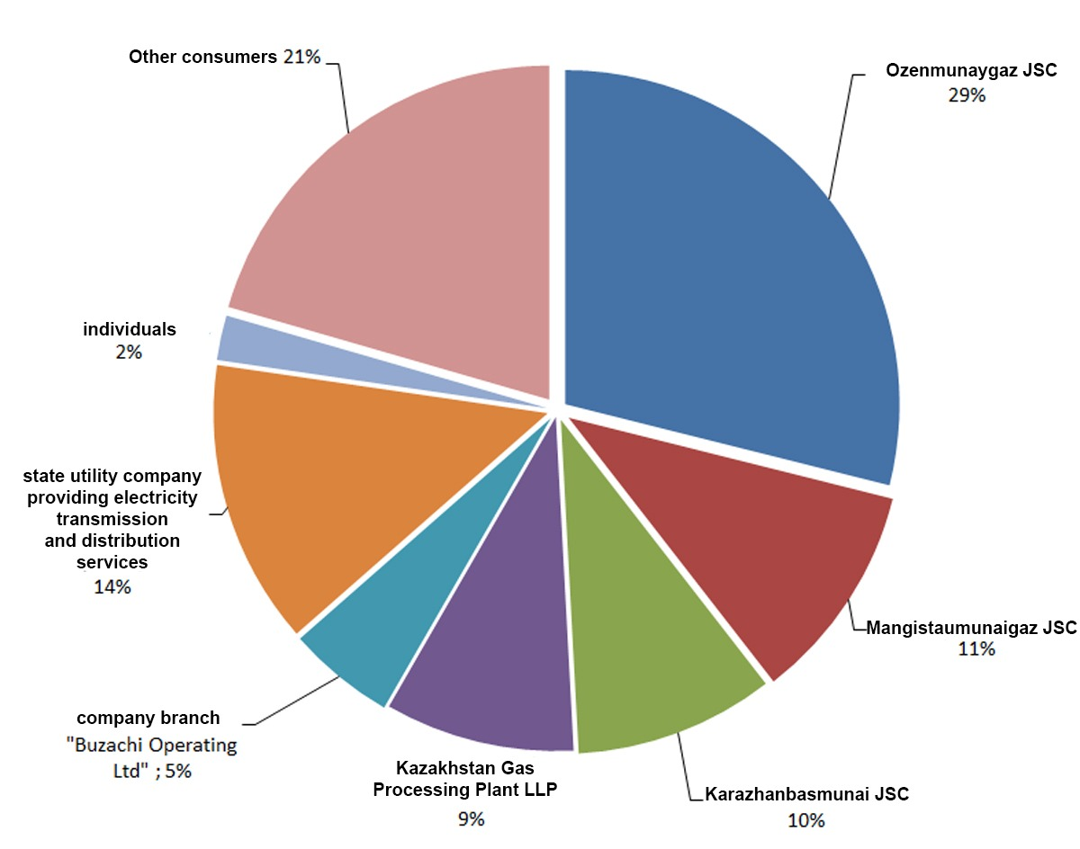
Volumes of provided regulated services for 2017
Name | Unit | 2016 | 2017 |  |  |  | 2017/
 |  |  |  |  |  |  | 2016
 |  | fact | plan | fact | off | % | %
Power transmission | million kWh | 2 490 | 2 520 | 2 558 | 38 | 101% | 103%
Large consumers:
Ozenmunaigas JSC - 739 million kW / h;
Mangistaumunaigaz JSC - 271 million kW / hour;
Karazhanbasmunai JSC - 247 million kW / h;
Kazakh Gas Refinery LLP - 235 million kW / h;
Branch of Buzachi Operating Ltd - 133 million kW / h;
State utility company providing electricity transmission and distribution services - 353 million kW / h.

Slide 6
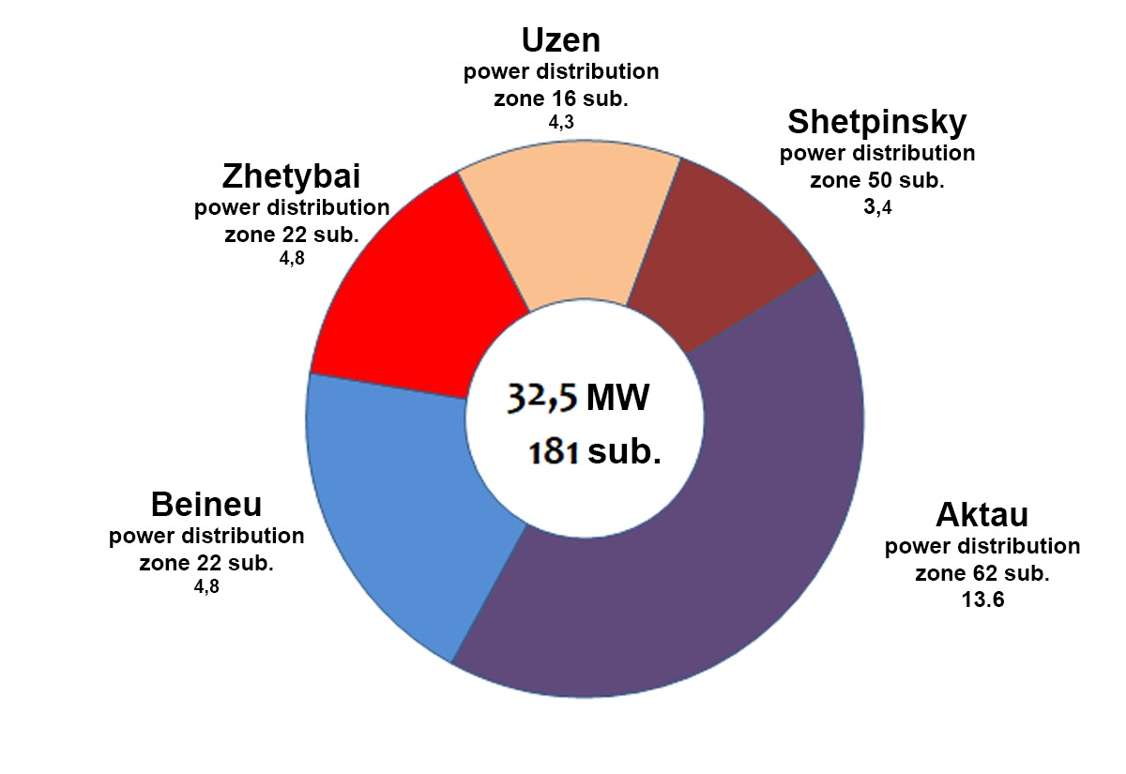
Ongoing work with consumers, including information on the issuance of new capacity
Issued Technical Conditions with breakdown by power knots
In 2017, the networks of JSC "MRPGC" transferred 37.9 MW of power to consumers, of which:
- 32.5 MW; technical specifications for power supply of newly connected consumers were issued in the amount of 181 pcs .;
- 5.4 MW are matched by the release of additional power for 43 sub-consumers.
Issued Technical conditions over 1 MW:
Kazakhstan Caspian Offshore Industries LLP for electricity supply to the Temir-at marine oil and gas equipment manufacturing plant in S.Shapagatov - 2,500 kW;
State Institution "Tupkaragansky District Department of Construction" for an additional 10 kV power transmission line for the Shpagatova plant, -2 000 kW;
JSC "Ozenmunaygaz" for the power supply of the workshop for the diagnosis and repair of underground equipment in the territory of NGDU-2.4 - 3 764 kW.
The dynamics of the issuance of capacity for technical conditions 2013—2017.
48,2 MW
51 MW
42,1 MW
30,8 MW

Slide 7
Execution of tariff estimates for 2017
No. | Name of indicators | Unit | 2017 |  | Off | Reasons for deviation
 |  |  | plan | fact | %
I | Costs of production of goods and provision of services (works), total | thousand KZT | 7 919 170 | 6 496 334 | 82% | Savings on the article "The cost of compensation for regulatory and technical losses"
1. | Material costs | thousand KZT | 3 324 105 | 1 937 301 | 58% | Savings on the article "The cost of compensation for regulatory and technical losses"
1.1. | Raw materials and supplies | thousand KZT | 60 465 | 59 579 | 99%
1.1.1. | Safety equipment, protective equipment, total | thousand KZT | 25 561 | 24 707 | 97%
1.1.2. | Maintenance materials, total | thousand KZT | 30 596 | 30 614 | 100%
1.1.3. | Purchased products and semi-finished products, auxiliary materials | thousand KZT | 4 308 | 4 257 | 99%
1.2. | Electricity for household needs | thousand KZT | 24 704 | 26 039 | 105%
1.3. | Fuels and lubricants | thousand KZT | 40 149 | 38 065 | 95% | Actual consumption and conversion of the vehicle fleet to gas
1.4. | Costs for compensation of normative and technical losses | thousand KZT | 3 198 788 | 1 813 618 | 57% | The reduction of losses is related to the implementation of measures aimed at reducing technical losses, such as optimization of electric network modes, replacement of wires on overloaded lines, introduction of Automatic system for commercial accounting of power consumption in 6-10 / 0.4 kV networks of JSC "MPDC" as part of the investment program, as well as the introduction of more efficient methods and technologies for the provision of regulated services. The savings made under this item were directed to the implementation of the JSC "MPDC" Investment Program in 2017
2. | Depreciation | thousand KZT | 1 636 569 | 1 637 696 | 100%
3. | Repairs | thousand KZT | 526,315 | 523,755 | 100%
 | Including capital repairs that do not lead to an increase in the value of fixed assets | thousand KZT | 526,315 | 523,755 | 100%
3.1. | Repair of fixed assets, total, including | thousand KZT | 296,700 | 296,695 | 100%
3.2. | The cost of materials for repair (economic method), total, including: | thousand KZT | 229,616 | 227,060 | 99%
3.2.1. | The cost of materials for major repairs, total, including: | thousand KZT | 187,025 | 184,867 | 99%
3.2.2. | The cost of materials for current repair, total, including: | thousand KZT | 42 590 | 42 193 | 99%
4. | Labor costs, total, including: | thousand KZT | 1 394 755 | 1 364 633 | 98%
4.1. | Wage | thousand KZT | 1 271 418 | 1 242 544 | 98%
4.2. | Deductions from remuneration (social tax and social insurance) | thousand KZT | 123,336 | 122,089 | 99%
5. | Tax payments | thousand KZT | 1 797 | 1 797 | 100%
6. | Services of third parties of production nature | thousand KZT | 924,392 | 919,294 | 99%
7. | Other costs | thousand KZT | 111,237 | 111,859 | 101%
II | Period expenses, total | thousand KZT | 1 928 452 | 1 658 133 | 86% | Savings on interest expense
8. | General and administrative expenses | thousand KZT | 1 128 353 | 1 123 242 | 100%
8.1. | Remuneration of administrative personnel | thousand KZT | 218,696 | 213,261 | 98%
8.2. | Deductions from wages of administrative personnel | thousand KZT | 26 639 | 23 143 | 87% | Due to the current savings in labor costs for administrative staff
8.4. | Depreciation | thousand KZT | 78 851 | 78 847 | 100%
8.5. | Tax payments | thousand KZT | 401,247 | 407,072 | 101%
8.6. | Business trips | thousand KZT | 19 190 | 19 156 | 100%
8.7. | Representation expenses | thousand KZT | 286 |  | 0% | Costs are charged on the fact, depending on the actual number of official receptions held.
8.8. | Communication services | thousand KZT | 10 275 | 9 986 | 97%
8.9. | Payment for consulting, audit and marketing services | thousand KZT | 16 913 | 16 913 | 100%
8.10. | Bank services | thousand KZT | 3 631 | 3 819 | 105%
8.11. | Other expenses | thousand KZT | 352,624 | 351,045 | 100%
8.11.1. | Payment for services of third-party organizations, total | thousand KZT | 52 584 | 53 797 | 102%
8.11.2. | Other expenses of general economic nature: | thousand KZT | 198,634 | 196,972 | 99%
8.11.3. | Electricity metering expenses | thousand KZT | 101,406 | 100,276 | 99%
9. | Interest expense | thousand KZT | 800,099 | 534,891 | 67% | Savings due to the late period of borrowing
III | Total costs | thousand KZT | 9 847 621 | 8 154 467 | 83%
IV | Profit | thousand KZT | 1 332 240 | 3 205 788 | 241% | In accordance with the Law of the Republic of Kazakhstan No. 272-I of July 9, 1998, “On Natural Monopolies”, the existing savings resulting from cost savings due to the use of more efficient methods and technologies, the implementation of an energy saving plan and energy efficiency measures, reduction of regulatory technical losses, was aimed at the implementation of the Investment program of JSC "MRPGC" in 2017
VI | Total income | thousand KZT | 11 179 862 | 11 360 254 | 102%
VII | Volume of services provided | thousand kW / hour | 2 520 355 | 2 558 087 | 101%
 | The volume of services provided, for legal entities | thousand kW / hour | 2 119 428 | 2 150 171 | 101%
 | The volume of services provided, for physical persons | thousand kW / hour | 53 019 | 55 392 | 104%
 | The volume of services rendered, the state-owned enterprise pre-requesting services for the transmission and distribution of electricity and Elektrzhuyieleri LLP carrying out activities for the supply of individuals (population) | thousand kW / hour | 347,908 | 352,523 | 101%
VIII | Normative losses | % | 8.21 | 5.51 | 67%
 |  | thousand kWh | 225,584 | 149,208 | 66%
 |  | thousand KZT | 3 198 788 | 1 813 618 | 57%
IХ | Average rate | tenge-tiyn / kW | 4.44 | 4.44 | 100%
 | Tariff (excluding VAT) for legal entities | tenge-tiyn / kW | 4.77 | 4.77 | 100%
 | Tariff (excluding VAT) for individuals | tenge-tiyn / kW | 2.17 | 2.17 | 100%
 | Tariff (excluding VAT) for a public utility providing services for the transmission and distribution of electricity | tenge-tiyn / kW | 2.74 | 2.74 | 100%

Slide 8
Main objectives for 2018
Ensuring reliable and uninterrupted power supply to consumers;
Implementation of an approved investment program;
Attraction of financing for implementation of the investment program;
Execution of the approved tariff estimates;
Achievement of approved key performance indicators;
Implementation of measures for creation of safe and healthy working conditions at each workplace, prevention of industrial injuries and occupational diseases.

